Slide 1
UML
Unified Modeling Language

Slide 2
UML
Modeling language that describe a software system at a high level of abstraction
It is a industry-standard graphical language for specifying, visualizing, constructing, and documenting the artifacts of software systems
The UML uses mostly graphical notations to express the OO analysis and design of software projects.
Simplifies the complex process of software design

Slide 3
UML
Use case diagrams
Describe the functional behavior of the system as seen by the user.
Sequence diagrams
Describe the dynamic behavior between actors and the system and between objects of the system.
Class diagrams
Describe the static structure of the system: Objects, Attributes, and Associations.
Statechart diagrams
Describe the dynamic behavior of an individual object as a finite state machine.
Activity diagrams
Model the dynamic behavior of a system, in particular the workflow, i.e. a flowchart.

Slide 4
Use Case Diagram
What is a Use Case Diagram?
A use case diagram is a visual representation of how users (actors) interact with a system to achieve specific goals.
It provides a high-level view of the system's functionality and helps to identify the key features and requirements.

Slide 5
Key Components of a Use Case Diagram
Actors
Represent entities that interact with the system.
Can be humans, external systems, or devices.
Depicted as stick figures.
Use Cases
Represent specific actions or functions that the system performs.
Describe the sequence of steps involved in completing a task.
Depicted as ellipses.

Slide 6
Key Components of a Use Case Diagram
Relationships:
Association: A line between an actor and a use case indicating interaction.
Dependency: A dashed line with an arrowhead, showing that one use case depends on another.
Generalization: A dashed line with a triangle, indicating a specialized use case (child) inherits behavior from a general use case (parent).
Include: A dashed line with a <<include>> showing a use case that is Subtask is included in another.
Extend: A dashed line with a <<extend>> showing an optional behavior that can be added to a base use case under certain conditions.

Slide 7
How to Create a Use Case Diagram
Identify Actors
Determine who or what will interact with the system.
2.Identify Use Cases
Define the key functions or goals the system should achieve.
3.Define Relationships
Establish how actors and use cases are connected.
4.Draw the Diagram
Use standard symbols and notations to create the diagram.

Slide 8
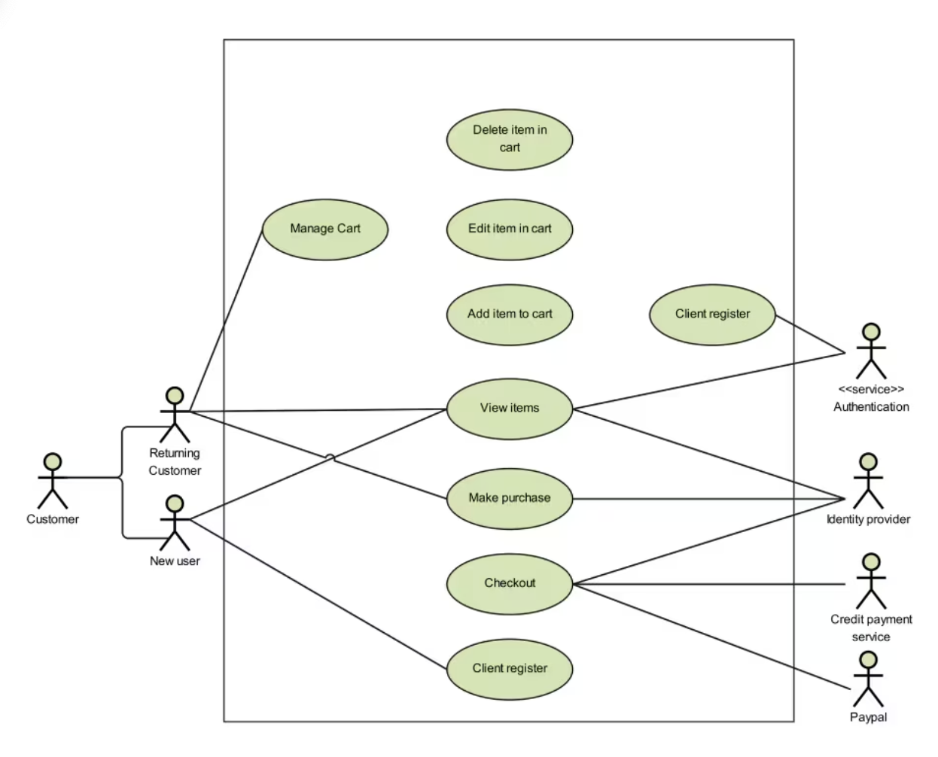
Example: Online Shopping System

Slide 9
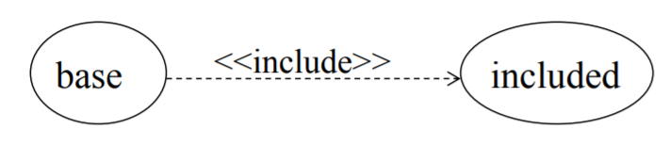
Include
The base use case explicitly incorporates the behaviour of another use case at a location specified in the base.
The included use case never stands alone. It only occurs as a part of some larger base that includes it.

Slide 10
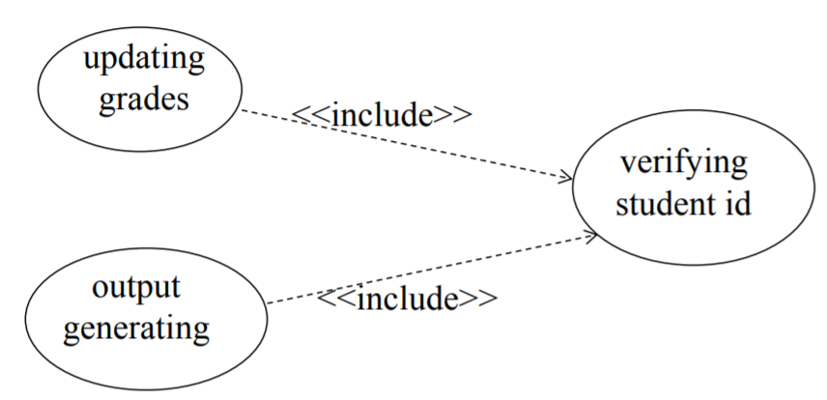
More about include
Enables us to avoid describing the same flow of events several times by putting the common behaviour in a use case of its own.

Slide 11
Include relationship
Include relationship – a standard case linked to a mandatory use case.
Standard use case can NOT execute without the include case i.e. tight coupling .

Slide 12
What is an extension?
A possible branch in a use case scenario, often triggered by an error or failure in the process.
Useful for finding edge cases that need to be handled and tested.
Think about how every step of the use case could fail.
Give a plausible response to each extension from the system.
Response should either jump to another step of the case, or end it.

Slide 13
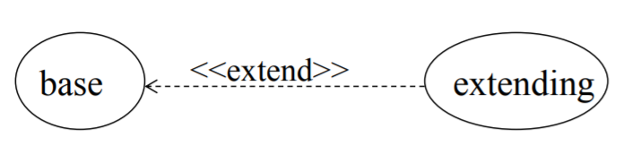
Extensions
The base use case implicitly incorporates the behaviour of another use case at certain points called extension points.
The base use case may stand alone, but under certain conditions its behaviour may be extended by the behaviour of another use case.

Slide 14
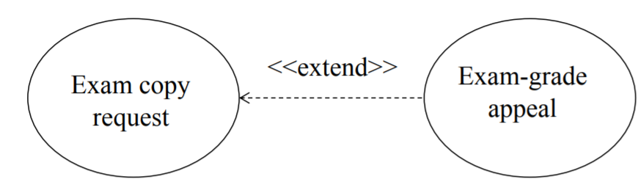
More about extensions
Enables to model optional behaviour or branching under conditions.
Extend relationship – linking an optional use case to a standard use case.

Slide 15
Benefits of Using Use Case Diagrams
Clear Communication: Visual representation helps stakeholders understand the system's functionality.
Requirement Gathering: Identifies system requirements from a user's perspective.
System Design: Guides the design of the system's components and interactions.
Testing: Provides a basis for test case design and execution.
Documentation: Serves as a valuable reference for future development and maintenance.

Slide 16
Sequence Diagrams
What is a Sequence Diagram?
A Visual Guide to System Interactions
A sequence diagram is a type of interaction diagram that illustrates the dynamic behavior of a system by showing the sequence of messages exchanged between objects over time.

Slide 17
Key Components of a Sequence Diagram
Participants: Objects or actors that interact with each other.
Lifelines: Vertical lines representing the existence of objects over time.
Messages: Horizontal arrows indicating communication between objects.
Activation Bars: Rectangles on lifelines showing the period during which an object is active.

Slide 18
Types of Messages
Synchronous Message: A message that requires a response before the sender can proceed.
Asynchronous Message: A message that doesn't require an immediate response.
Return Message: A message sent back as a response to a synchronous message.

Slide 19
How to Create a Sequence Diagram
Identify Participants: Determine the objects or actors involved in the interaction.
Define the Sequence: Determine the order of messages exchanged between participants.
Draw Lifelines: Create vertical lines for each participant.
Add Messages: Draw horizontal arrows to represent message exchanges.
Add Activation Bars: Indicate the periods of activity for each participant.

Slide 20
Sequence diagram for shopping cart

Slide 21
Sequence diagram for Library management system

Slide 22
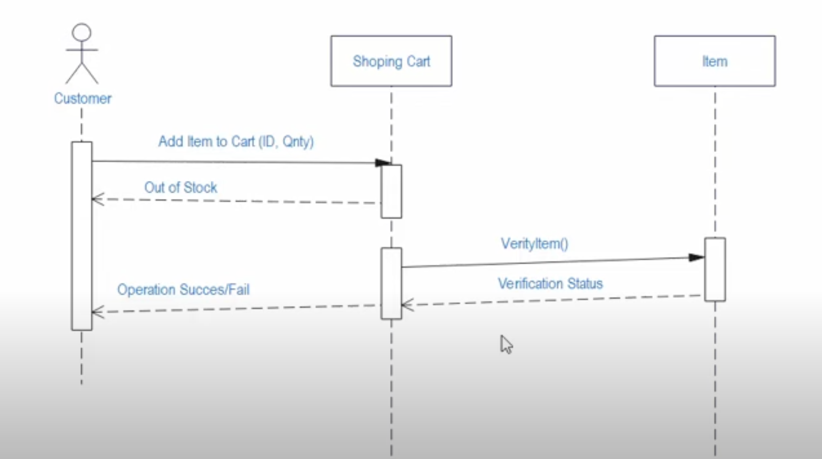
Sequence diagram for shopping cart

Slide 23
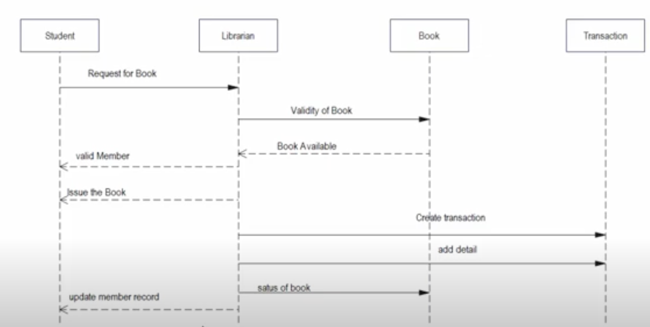
Sequence diagram for Library management system

